Slide 1
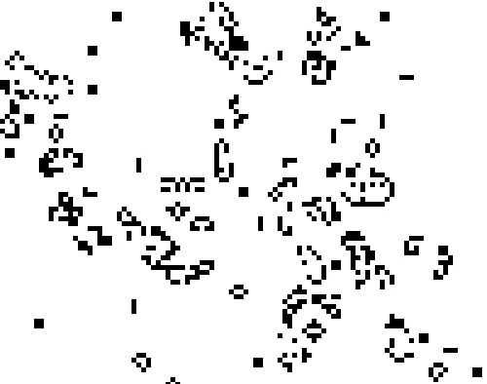
Game Of Life
Josh Meyers
Zero player game where you see how cells develop following these rules. If the cell is alive, then it stays alive if it has 2 or 3 alive neighbors. If the cell is dead, then it springs to life if it has 3 alive neighbors.

